Slide 1

Maintenance Executive Overview Briefing

Slide 2

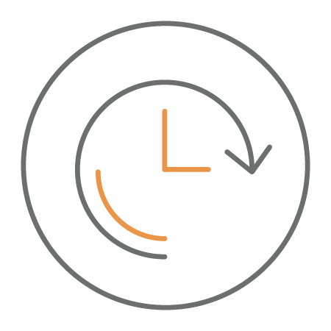
Categories
What will these Key Performance Indicators (KPIs) allow me to do?
Increase maintenance staff efficiency and overall productivity, streamline workflows, improve customer engagement and satisfaction, capture and show productivity gains, and track overall health of your maintenance program
maintenance
Determine success of your preventive maintenance program, transition to being more proactive, reduce backlogged work, increase life expectancy of equipment, and decrease catastrophic failures
preventive
Time Frame
Key Performance Indicators (KPIs): Past 12 Months
Trends: Past 3 Years, plus current year

Slide 3

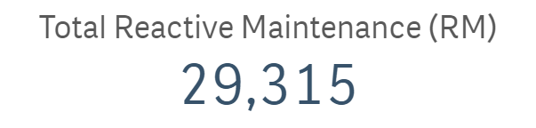
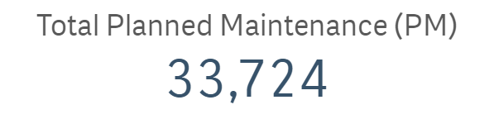
Total Number of Work Orders
This reflects how many repairs and jobs were captured in the 12 month rolling window. (includes all statuses)

Slide 4
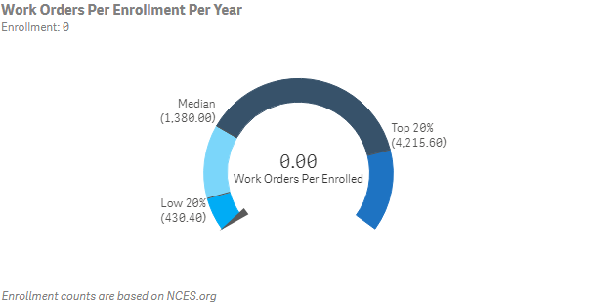
Work Orders Per Enrollment Per Year
This metric is an indicator of how much work is being captured and also serves as a measurement of software utilization. Far below average can indicate you are not capturing all work being performed. Far above the average may be a sign of trying to capture too much at the risk of becoming inefficient. This metric is important because the more work is captured, cases can be stronger for justifying resources. (rolling 12 Months, ignores rejected work)

Slide 5
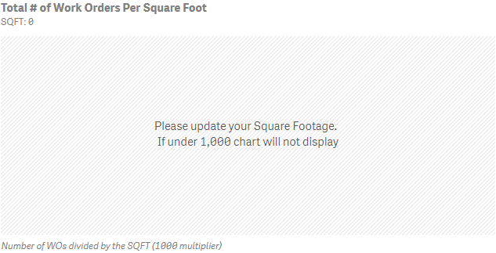
Work Orders Per Squarefoot
Total count of work orders for a 12 month rolling window (this month – last 12 months, ignores rejected work) divided by the total sum of square footage.

Slide 6
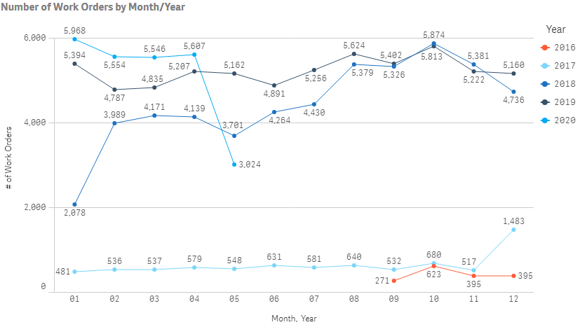
Total Number of Work Orders by Month/Year
Trend: Past 3 Years, plus current date: based on Created Date

Slide 7
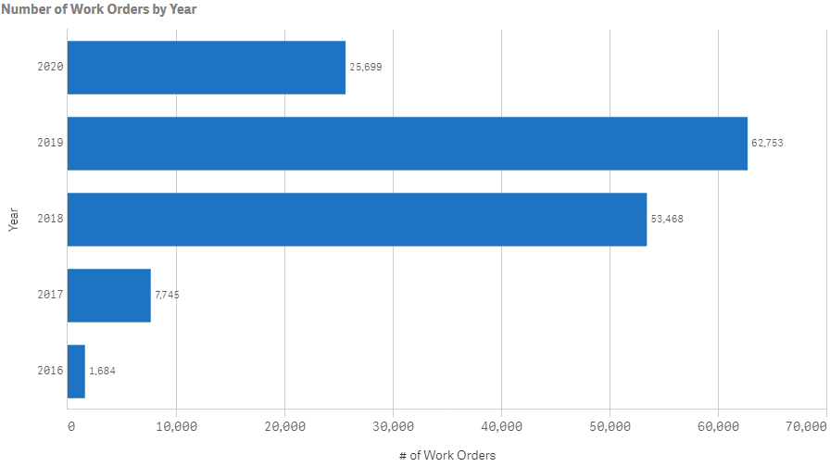
Total Number of Work Orders by Year

Slide 8
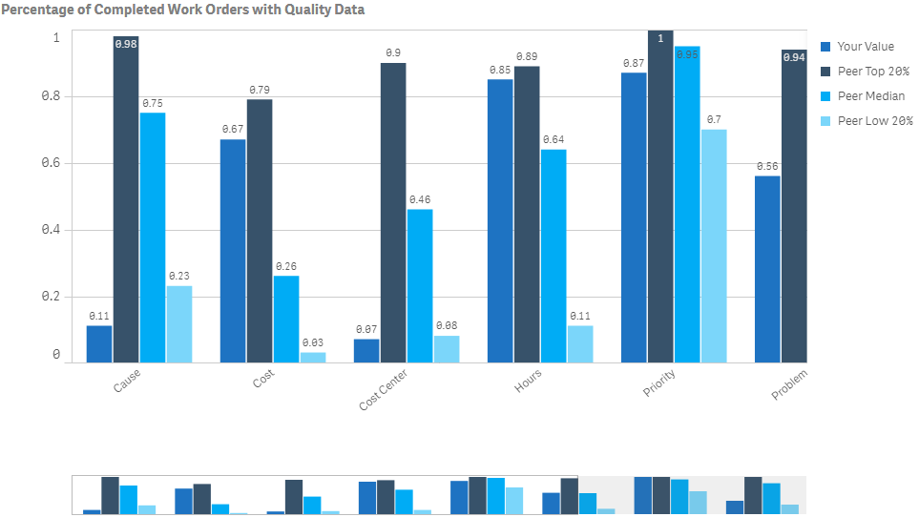
Percentage of Completed Work with Data Quality

Slide 9
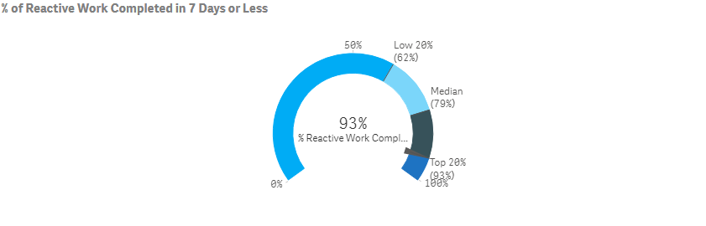
Percentage of Work Orders Completed in Less than a Week
This KPI indicates how much work an institution is able to complete in 7 calendar days. Below the national average suggests potential process improvements for managing and completing work. Above the national average could be a sign you have embraced mobile, your staff completes their own work assignments online and/or have reduced (or eliminated) paper in your processes. This compares Completion Date – Start Date (uses Request Date if Start Date is not used) for WO’s with a Priority of Low, Med or High & ignores PM’s to see what % of PM WO’s are completed in 7 Days or Less. (Rolling 12 Months)

Slide 10
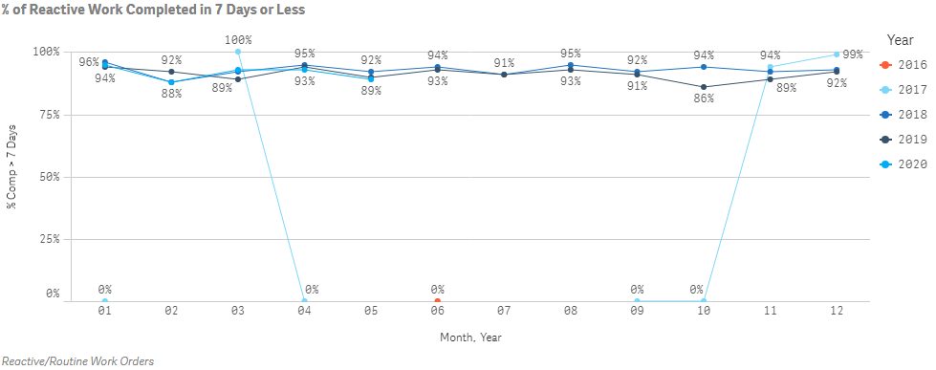
% of Reactive Work Completed in a Week or Less by Month/Year
This compares Completion Date – Start Date (uses Request Date if Start Date is not used) for WO’s with a Priority of Low, Med or High & ignores PM’s to see what % of PM WO’s are completed in 7 Days or Less. (Trend: Past 3 Years, plus current date: based on Completion Date)

Slide 11
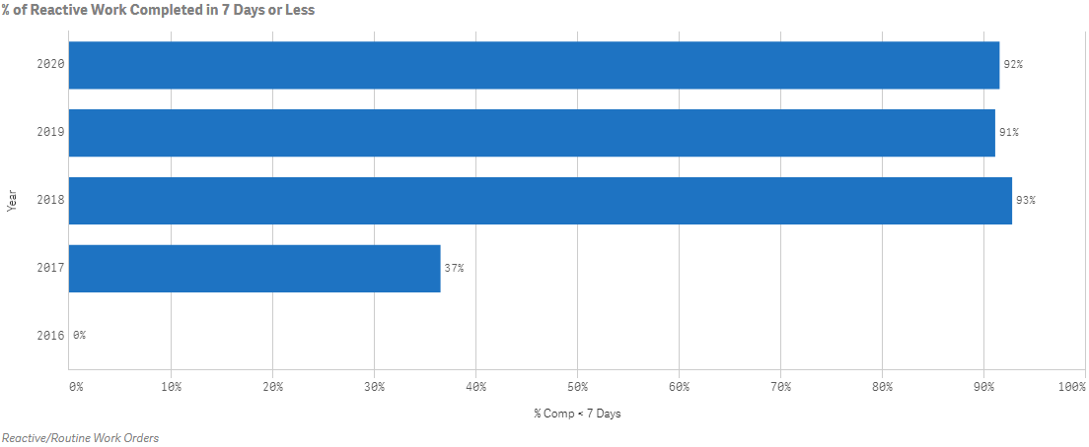
% RM WOs Completed in a Week by Year

Slide 12
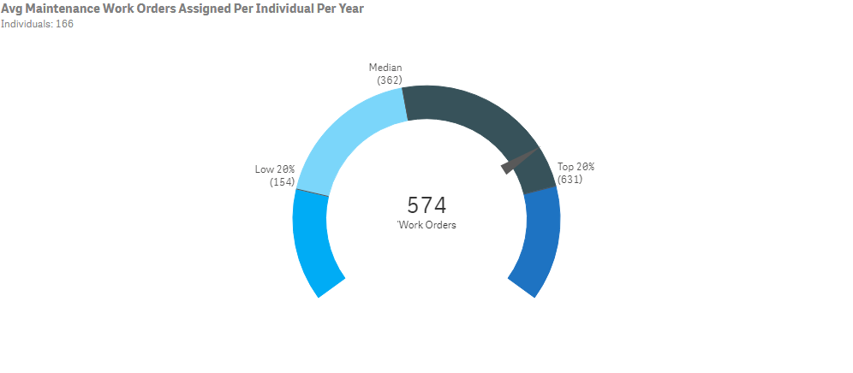
Average Count of Work Orders Per Employee Per Year
This metric gives you a direct comparison of your staff’s productivity compared to peer institutions. Employees are users who have been assigned more than 30 work orders, but less than 2,000 in a rolling 12 month window.

Slide 13
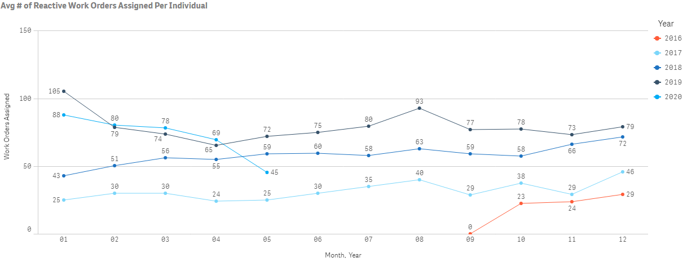
Average Work Orders Per Employee by Month/Year

Slide 14
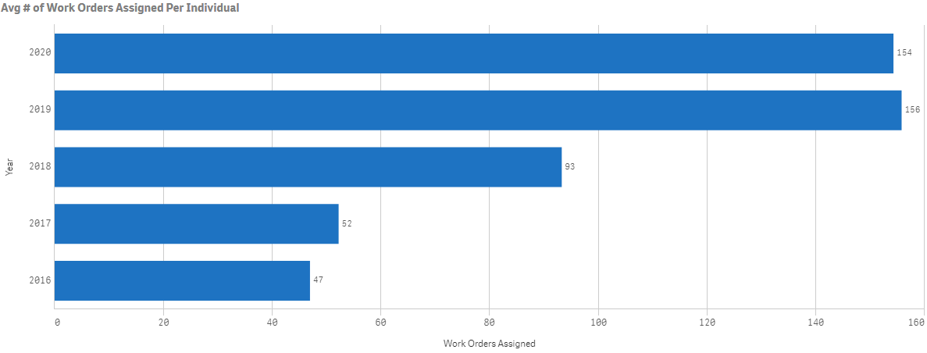
Average Work Orders Per Individual by Year
Trend: Past 3 Years, plus current date: based on Created Date

Slide 15
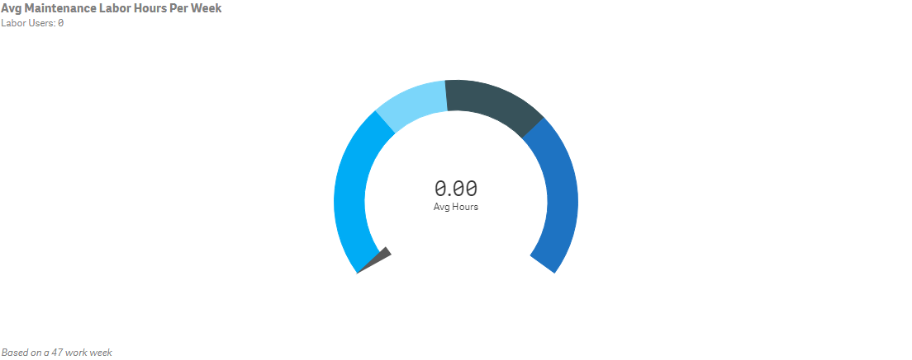
Average Hours Per Employee Per Week

Slide 16
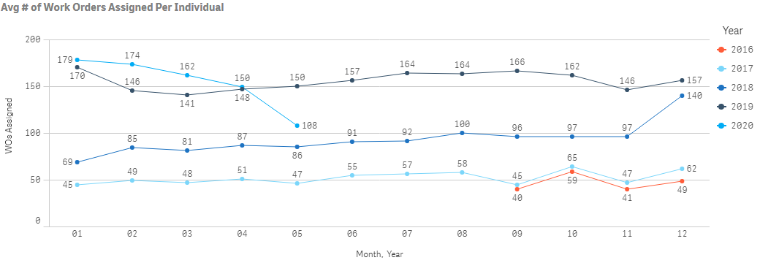
Average Number of WOs per Employee by Month, Year
This metric reflects how well you are capturing labor transaction data along with the productivity of your staff. The hours captured in this metric are “wrench turning” hours that are performed on the actual work order. Institutions that implement productivity strategies increase wrench turning time up to four hours per week. That’s the equivalent of adding more than a month of productive time per year. Employees are users with more than 500 hours, but less than 3,000 in a rolling 12 months window.

Slide 17
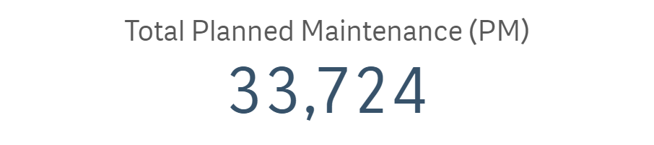

Total Number of PM Work Orders Generated over past 12 Months
Rolling 12 Months, includes all statuses

Slide 18
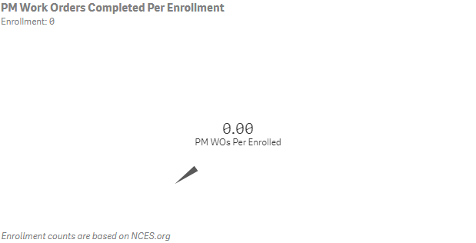
PM WOs Completed per Enrollment
This metric is used along with the PM/WO ratio to gauge the strength of your PM program. Implementing a strong PM program typically has an ROI within 1-2 years by reducing system failures and emergencies, extending equipment life and decreasing energy consumption. Increasing PM work can also help make workers' schedules more predictable as organizations performing more PM work see reductions in reactive work over time. (Rolling 12 Months, ignores rejected work)

Slide 19
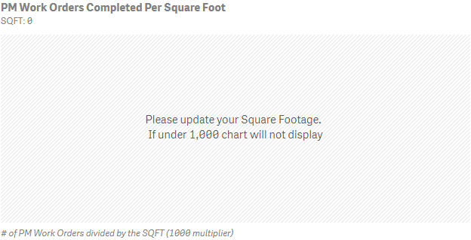
PM Work Orders per Squarefoot
KPI: Rolling 12 Months

Slide 20
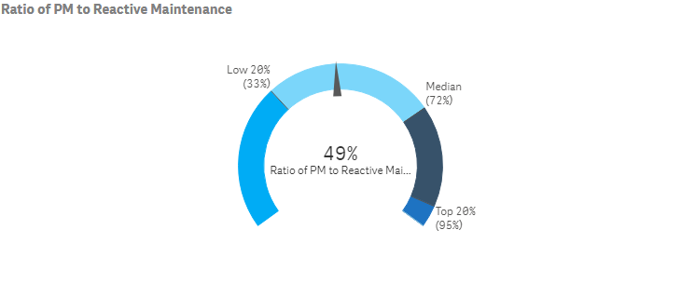
Ratio of PM Work Orders to Reactive Work Orders
This metric lets you evaluate how successful your institution has been at transitioning from a reactive to a proactive mindset and indicates how much of your M&O resources are dedicated to PM vs Reactive work. As more time is invested into PMs, you should see a decrease in reactive work, an increase in cycle times and an improved learning environment. (Rolling 12 Months)

Slide 21
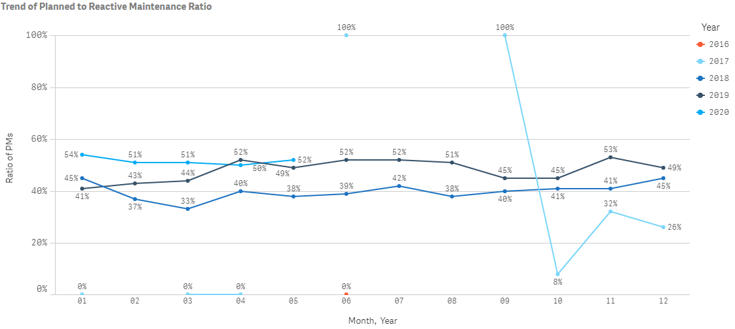
Ratio of PM to RM by Month/Year
Trend: Past 3 Years, plus current date: based on Created Date

Slide 22
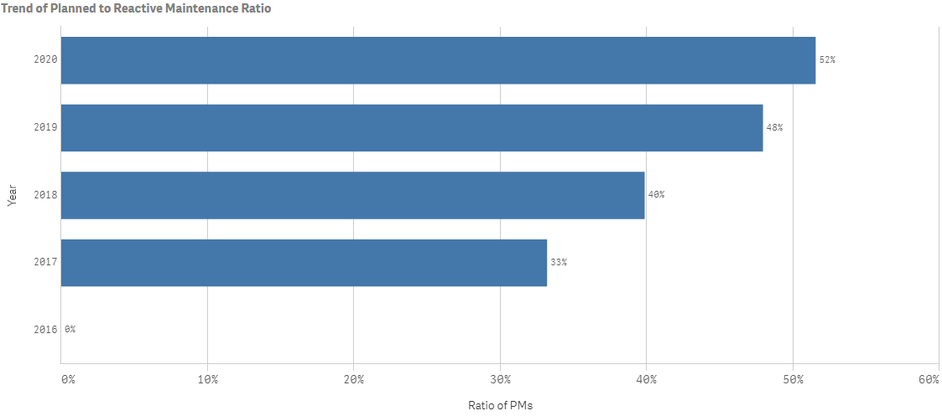
Ratio of PM to CM by Year
Trend: Past 3 Years, plus current date: based on Created Date

Slide 23
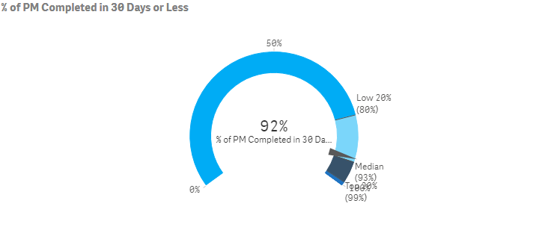
Percentage of PM WOs Completed in a Month or Less
This metric is a measurement of the responsiveness of proactive work. An above average measurement here leads to higher productivity and a decrease in backlog. This compares Completion Date – Start Date (uses Request Date if Start Date is not used) to see what % of PM WO’s are completed in 30 Days or Less. (Rolling 12 Months)

Slide 24
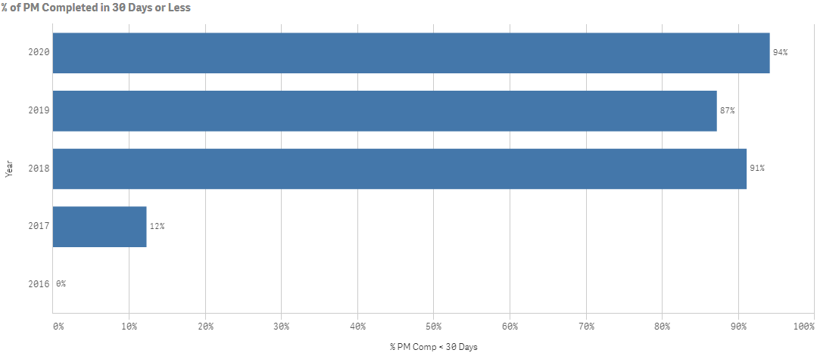
% of PMs Completed 30 Days or Less by Year
Trend: Past 3 Years, plus current date: based on Completion Date

Slide 25
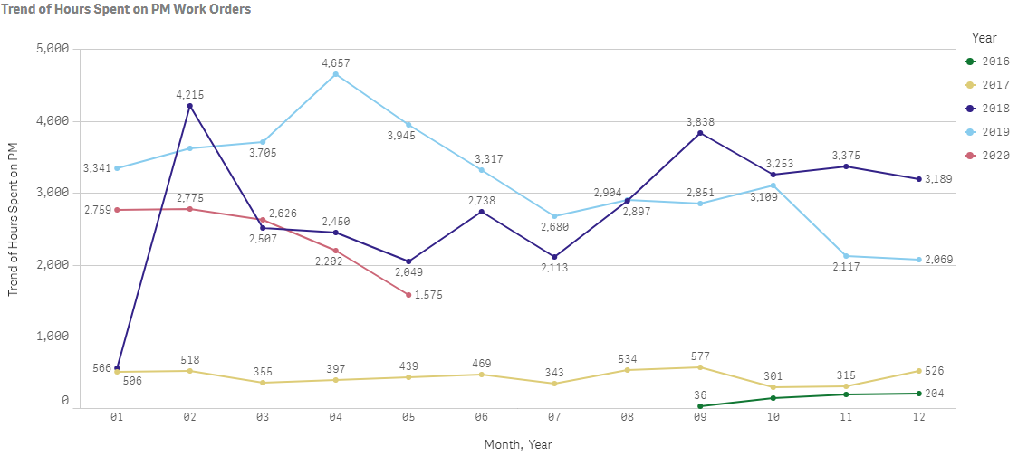
Hours Spent on PMs by Month, Year

Slide 26
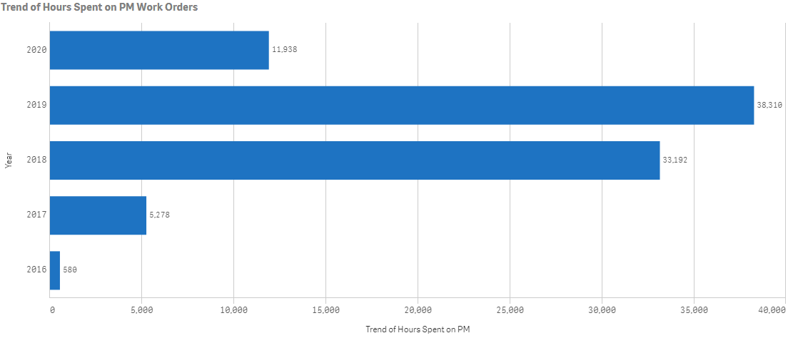
Hours Spent on PM by Year
Trend: Past 3 Years, plus current date: based on Created Date

Slide 27


Scheduled PMs for the Next 12 Months
KPI: Next 12 Months

